Slide 1
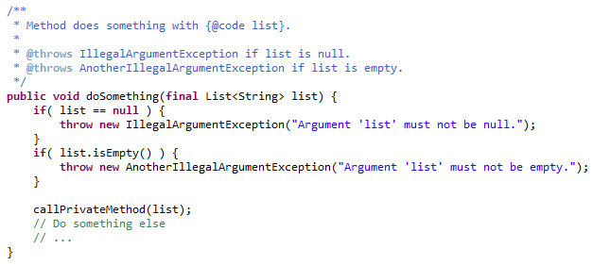
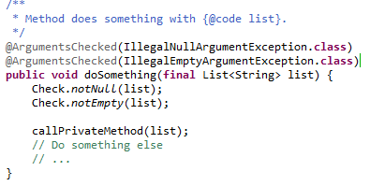
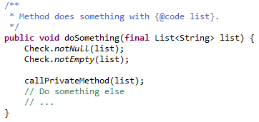
The Quality-Check Way
Replace manual checks with calls to Quality-Check.
Remove unnecessary JavaDoc – focus on important documentation.
Mark method as checked using @ArgumentsChecked annotation.

